Slide 1

Analyzing WebMD drug reviews
By: Kelvin Encarnacao, Abhinav Raghupathy, Jay Jiang

Slide 2
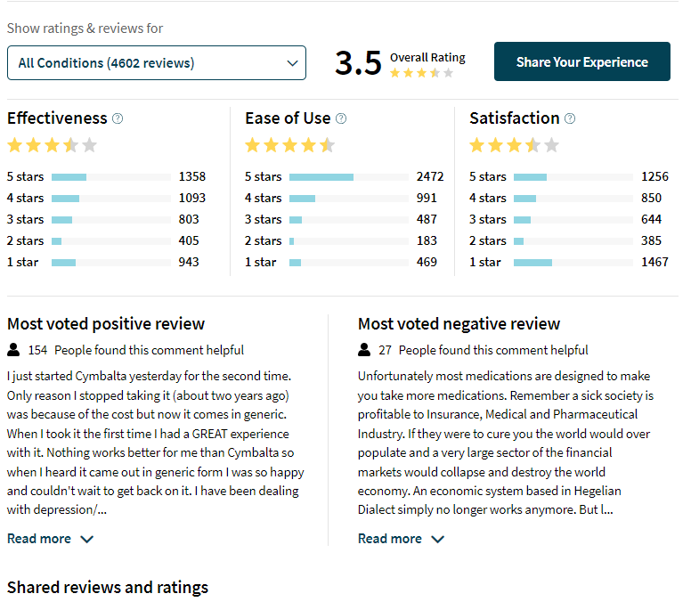
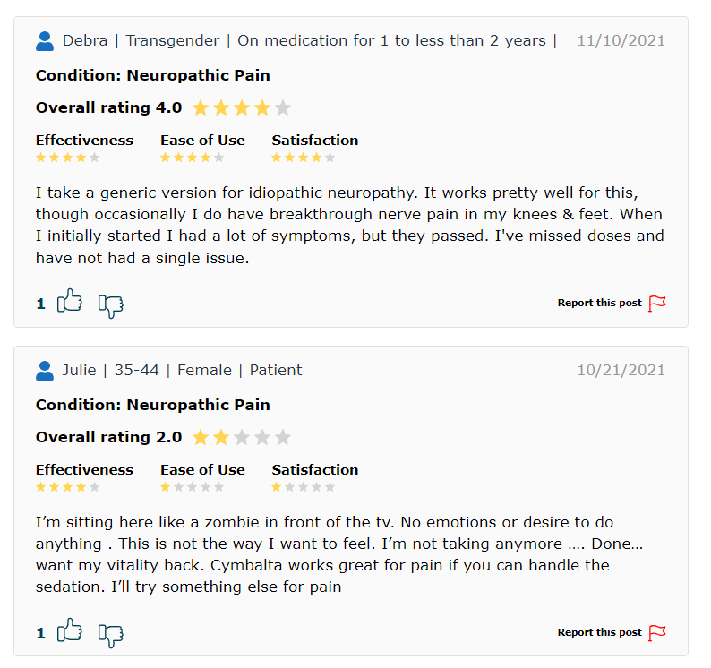
WebMD Reviews
Notes:
6572 different drugs in dataset, 1806 different conditions, 360,000 total reviews in dataset

Slide 3
Background
Project Goals
WebMD reviews dataset from Kaggle
Reviews from 9/2007-3/2020
300,000+ total reviews
6,572 total drugs
1,806 total conditions
What can we learn regarding drug associations and adverse effects from reviews?
How can we analyze text within reviews to learn about drugs and behavior on WebMD?
Identify use cases for utilizing processed review data in health and pharma context
Notes:
Drug associations = network
Use cases = specific drugs and how pha can use this info.

Slide 4
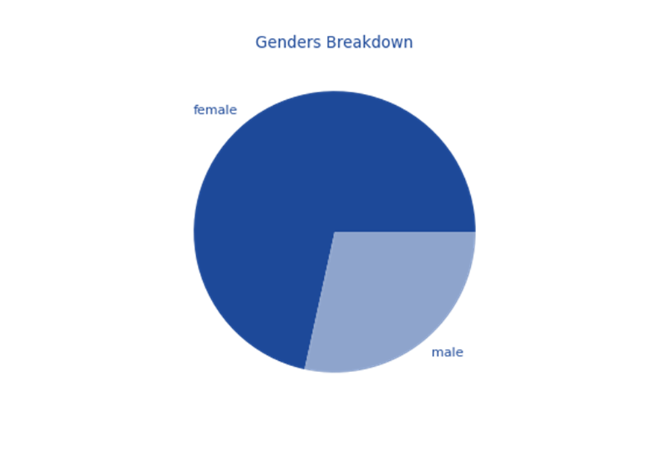
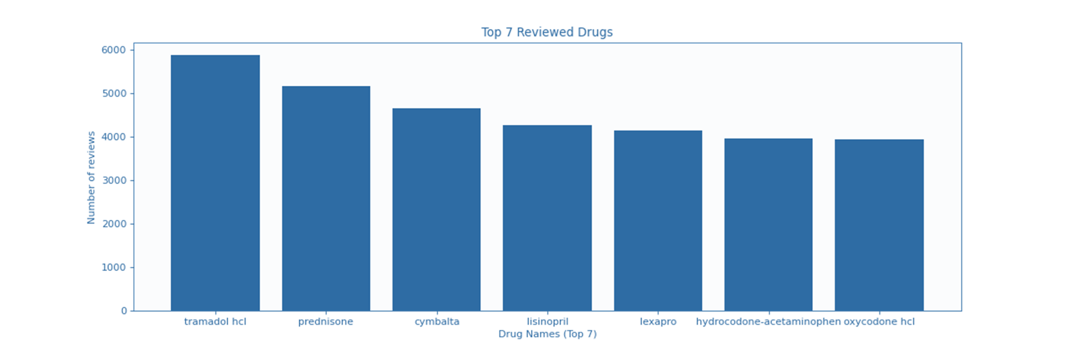
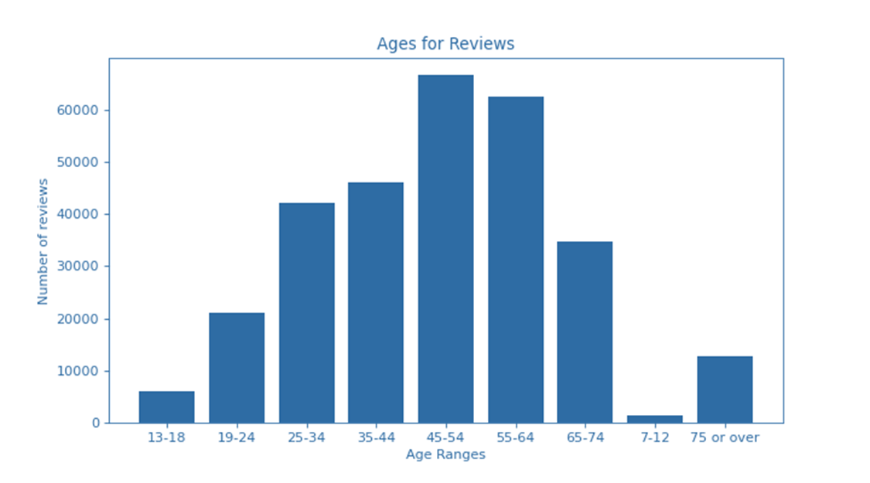
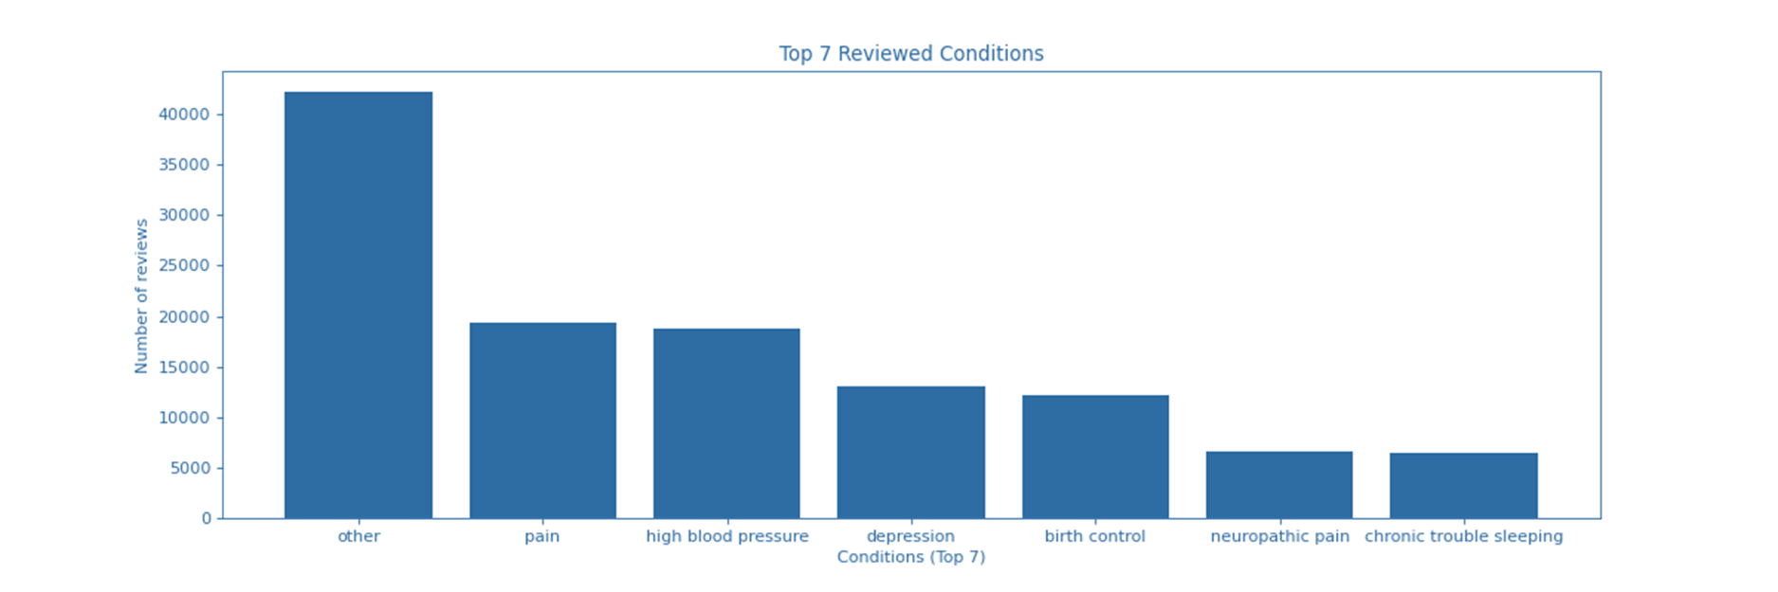
Data Breakdown

Slide 5
Data Preprocessing
Data Issues
Stopword removal in reviews
Merging of drugs by Id number
Drop row duplicates
Fill NaN values
Drug similarities
Condition similarities
Botted reviews
Low frequency review skewing
Notes:
Simple preprocessing of dataset and some issues we had to either deal with or ignore but still identify as they could cause some issues in later analysis.
Similarities - whether to count drugs as the same or not if under different id but very similar, adderall vs adderall XR, same with conditions just different wording
Skewing - some drugs with only 1 review with can mess with analysis
Condition simi = depression, depression and etc.
some reviews have different drug names with same id. scripting issue when they got the data.

Slide 6
How to analyze and learn from drug-condition
relationships in online text reviews?
Drug Focus: Amoxicillin and Prozac
Notes:
Our first question to try and answer?

Slide 7
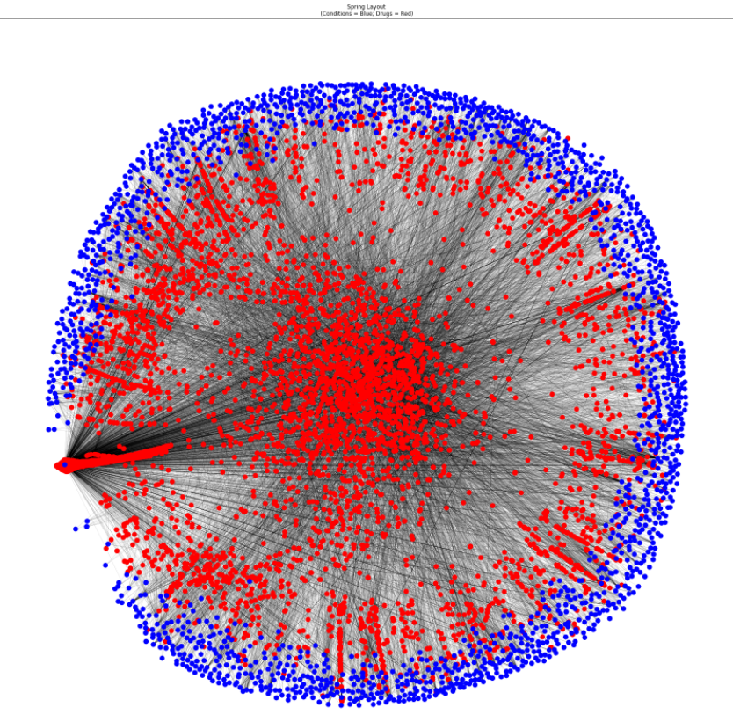
Drugs and Conditions
Drugs = red
Conditions = blue
Edges for drug review written for specific condition
Notes:
This network shows red for drug nodes and blue for condition nodes and each drug node has directed edges toward each condition for which the drug has been reviewed for. Can use in different ways, to see which drugs are mentioned with highest number of different conditions, which conditions are reviewed with the highest number of different drugs. Which drugs are most similar in terms of which conditions they are reviewed with etc. Which conditions are most associated in reviews with a drug etc.

Slide 8
Degree Centrality Measures
Top 5 Out-Degree (Drugs)
Prednisone
Cipro
Methylprednisolone
Ciprofloxacin
Levaquin
*Drugs with highest number of different associated conditions in reviews
Top 5 In-Degree (Condition)
Other
Osteoporosis
Birth control
High blood pressure
Acne
*Conditions associated with the most different drugs in entire webmd reviews dataset
Notes:
Means that these drugs apply to many different things and can be used in a variety of ways whereas vice versa the lowest out degree drugs would be more niche and catered toward a single condition.
Means that these conditions have the highest amount of different drugs on webmd that can be used to treat them, more common conditions - high blood pressure, osteoporosis, birth control

Slide 9
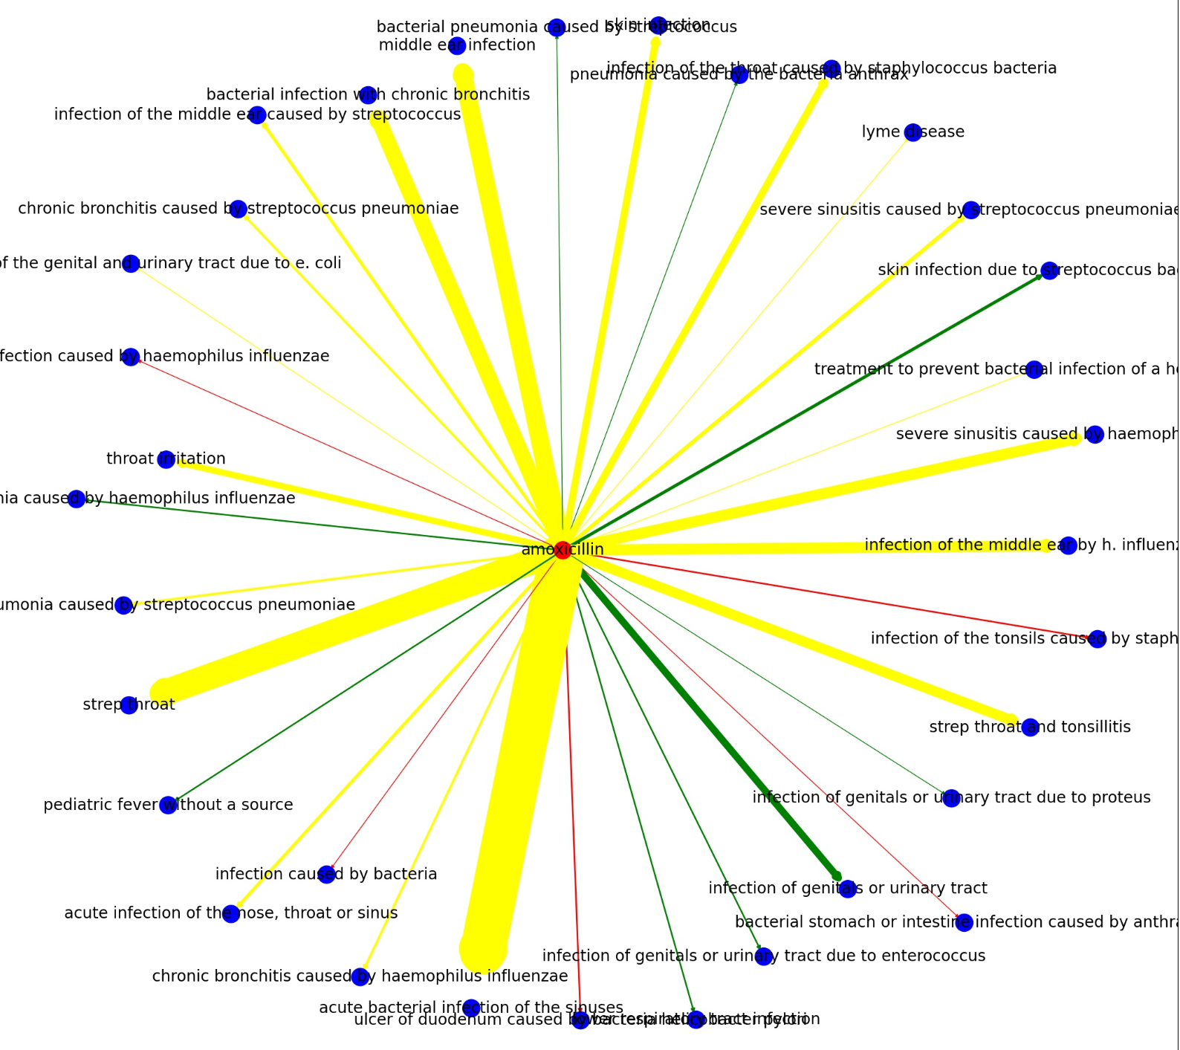
Drug Use Case
Drug: Amoxicillin
Edge width for review frequency
Color by satisfaction
Condition associations
Application
Notes:
Zoomed in on single node for better understanding or how this can be used to gain insights. Looking at amoxicillin and the different conditions around 35 that have been identified as used for in a review and weighted by the number of reviews for each specific condition. Amoxicillin is an antibiotic commonly used for bacterial infections

Slide 10
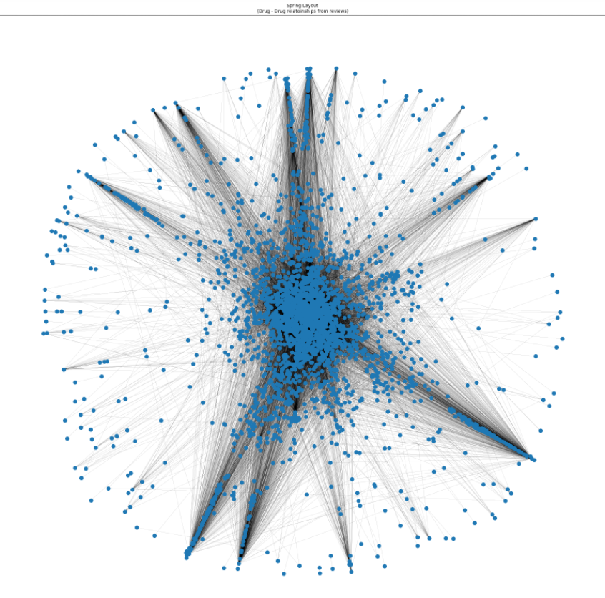
Drug-Drug relationships
Nodes = Drugs
Edges displaying drug’s appearance in another drug’s review
Notes:
Directed edge from drug1 to drug2 if drug2 was mentioned in a review for drug1.

Slide 11
Degree Centrality Measures
Top 5 In-Degree - Drugs
Tylenol
Prednisone
Benadryl
Ibuprofen
Aspirin
*Drugs mentioned the highest number of times in other drug reviews
Top 5 Out-Degree - Drugs
Cymbalta
Lisinopril
Topamax
Prednisone
Lyrica
*Drugs with the most mentions of different drugs in reviews
Notes:
Top 5 In Degree: which drugs have the highest number of mentions within reviews of other drugs
Top5 out Degree: which drugs have had the highest number of other drugs mentioned in it’s reviews
WHAT MIGHT THIS MEAN FOR THESE DRUGS

Slide 12
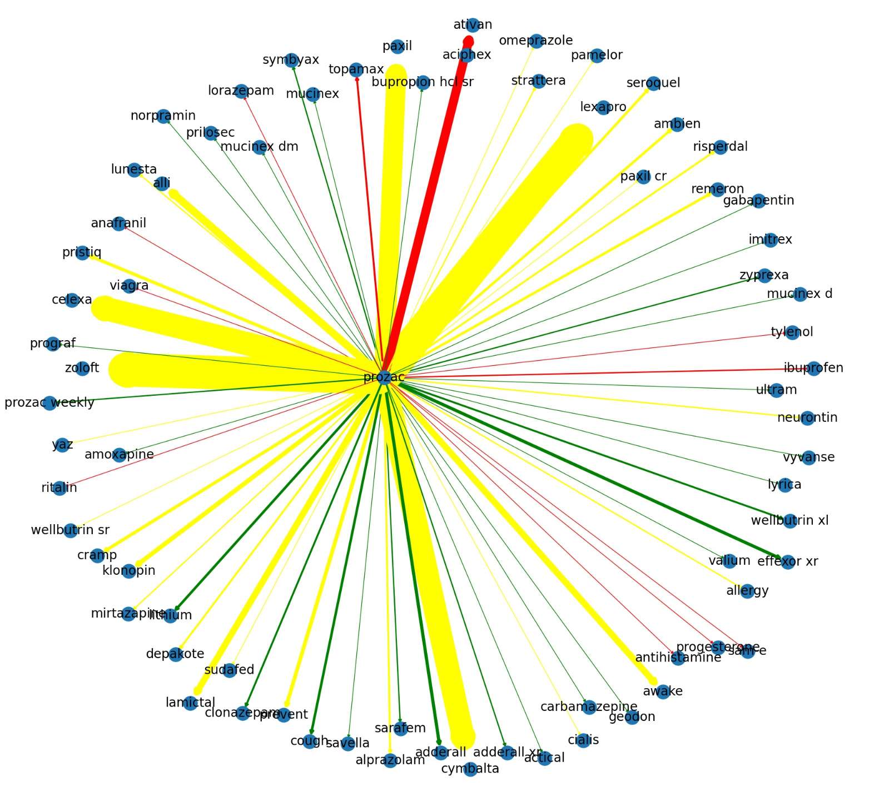
Drug Use Case
Drug: Prozac
Weighted edges based on number of times (other) drug was mentioned in a review.
Related drugs from user experiences - different insights
Looking deeper at edges example: Topamax

Slide 13
Prozac case - closer look at edges (Topamax)
What do these reviews look like?
My depression was caused by side-effects from an anti-epileptic drug I got prescribed a few months earlier (topamax). Prozac certainly stopped the depression - in less than 2wks I was completely homicidal! If I'd had the means I would have been a clock-tower sniper! PROZAC IS DANGEROUS!!!! Needless to say, I was taken off the drug immediately - put into respite and lost my son until 'I' could prove that I was sane. Thanks Prozac. - 1 star
At first, It started off well, over the years, I have noticed that it is not as effective. At first I was diagnosed with basic depression and It worked fine and now I have been diagnosed with bio bolar and I think that the treatment is no longer sufficient and I am seeking alternative treatment for my condition. I am currently taking 40 mg of Prozac and 400 mg of Topamax and feel worse then ever. A concerned patient. - 2 star
I was given this by my Rheumatologist to treat my arthritis but it did nothing to relieve the pain and inflammation. I'm on Topamax and Metoprolol and it just made my migraines come on with a vengeance and thank god i have nitro pills. This is not for arthritis as he claims it to be!!! -1 star
Useful for drug manufacturers, individuals and health professionals
Potential drug interactions discovery

Slide 14
How to analyze text within reviews to learn about drugs and online drug forum behavior?
Drug Focus: Adderall

Slide 15
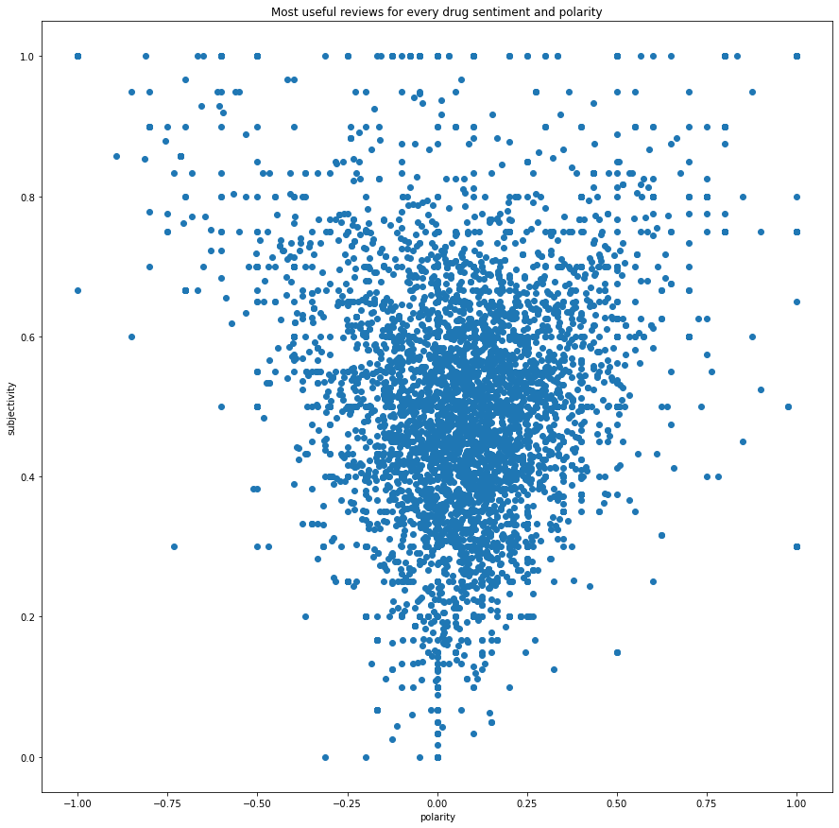
Most Useful Reviews
Sentiment score for most upvoted reviews
Broad range of both polarity and subjectivity
Clusters
What reviews people will see
Notes:
Interesting shape.

Slide 16
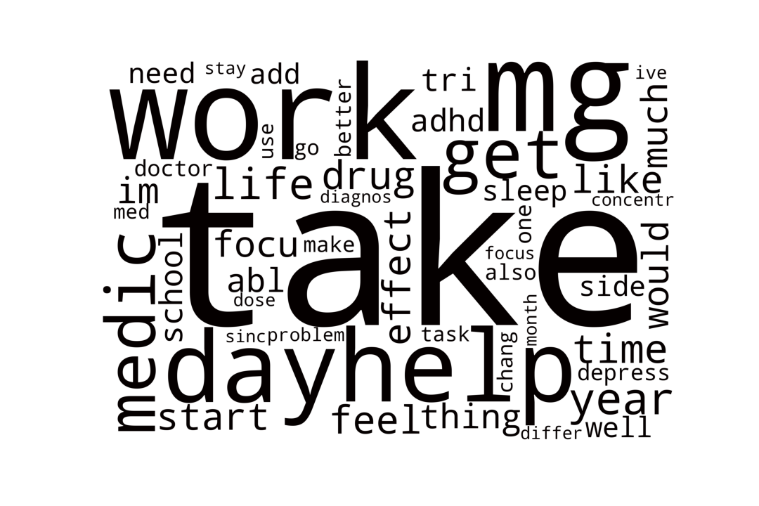
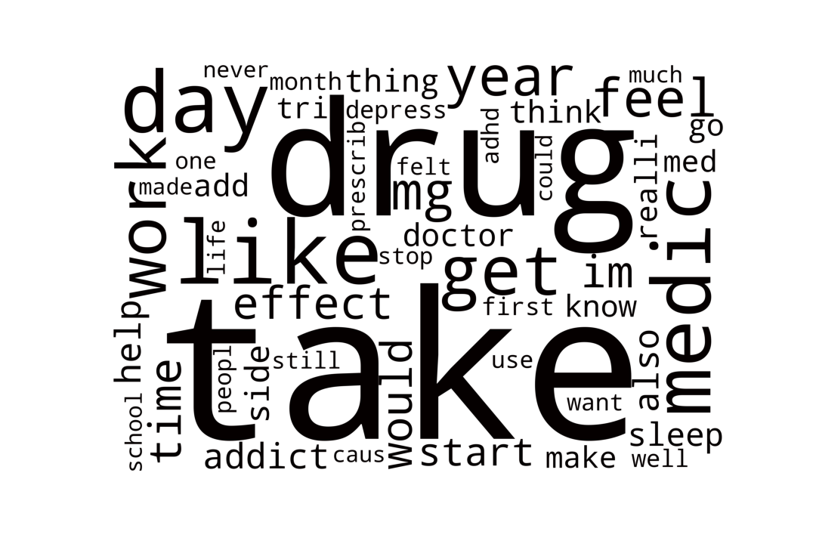
Reviews by Satisfaction - Adderall - Word Clouds
Most Satisfied (4-5 star)
Least Satisfied (1-2 star)
Good start however, not enough context and many similar terms...
Notes:
Notable 4-5 star words: need, like, focus, feel, able, better
Notable 1-2 star: depress, addict, stop

Slide 17
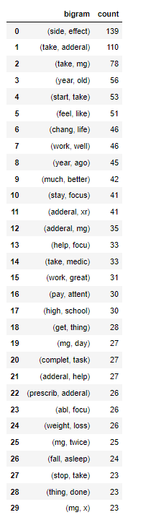
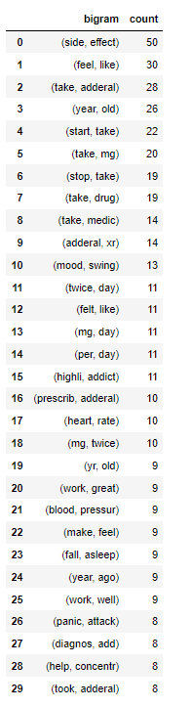
Adderall review analysis cont.
Most Satisfied (4-5 star)
Least Satisfied (1-2 star)
Notable positive pairs:
(chang, life)
(work, well)
(much, better)
(help, focus)
(pay, attent)
(complet, task)
Notable negative pairs:
(stop, take)
(mood, swing)
(highli, addict)
(heart, rate)
(blood, pressur)
(panic, attack)
*side effect identification
Notes:
Continued adderall satisfaction analysis, - Bigrams for most and least satisfaction reviews
Positive- allows us to get a little more context into why these people are giving the drug a positive review and what things they are accounting for in their positive reviews.
Negative- allows us to get more context into why people are reviewing this negatively, note some positive word pairs in , allow us to identify negative side effects

Slide 18
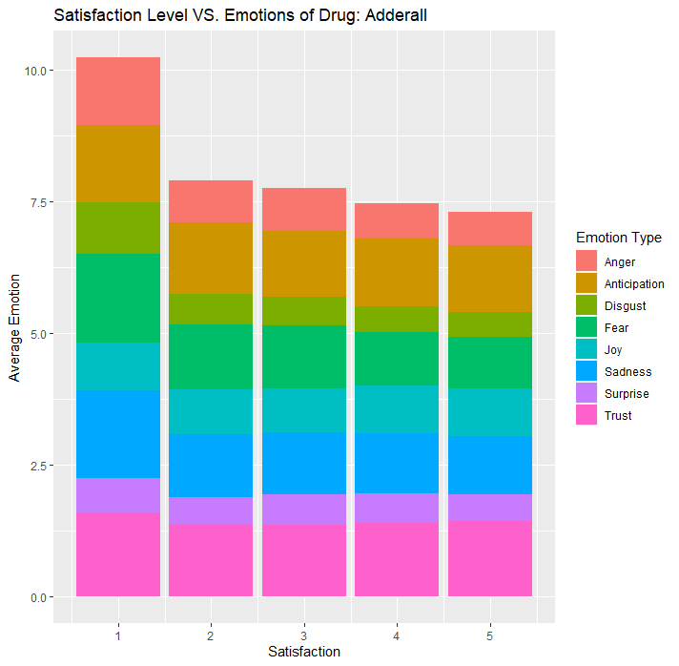
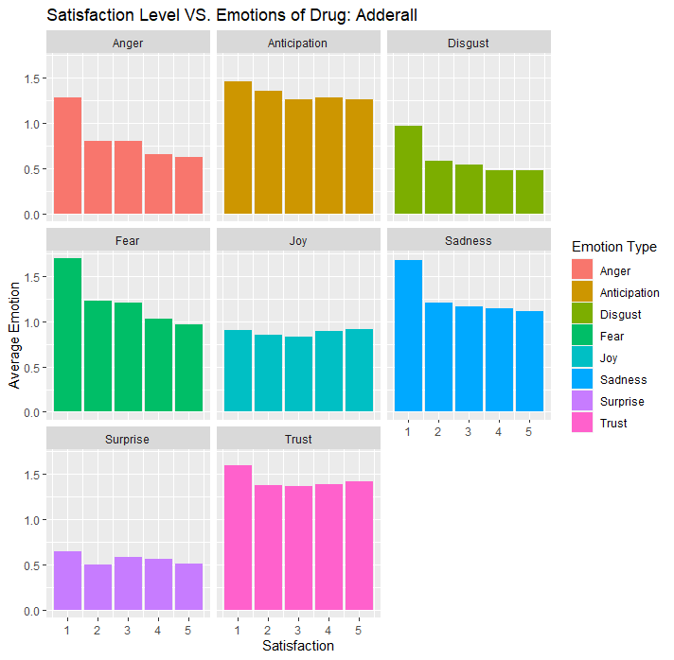
Emotions of review by satisfaction rating
Notes:
Less total emotions for higher satisfaction - people who rate higher have less emotion total and
Left graph is stackged together, right is separating them into different emotions
hen giving 1 start = they are more emotion than 2 - 5 stars
when giving 3 they are not super emotions, they are not writing bad words and more average review.

Slide 19
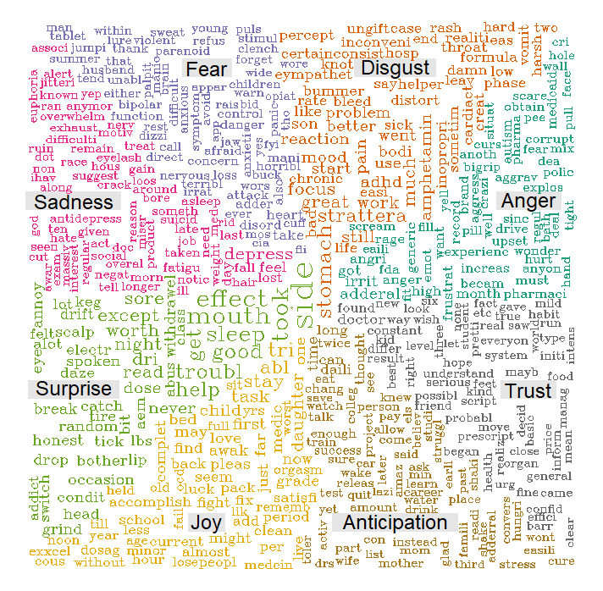
What Content Dominated Expressions of Different
Emotions of Adderall Reviews?

Slide 20
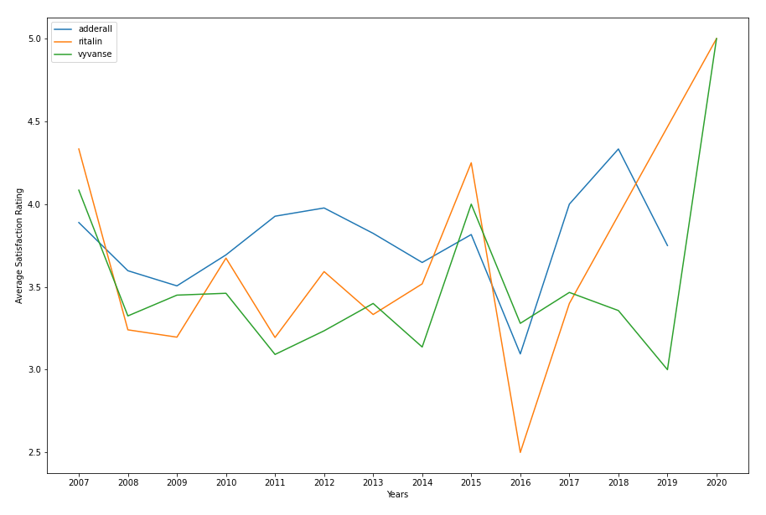
Drug Satisfaction - Competitor Analysis
Notes:
Adderall compared to other similar drugs.
Used to evaluate performance

Slide 21
Conclusion & Applications
Key takeaways:
WebMD reviews utilization for learning
Identifying drug connections with different conditions and drugs
General drug insights from public user experiences
Applications:
Pharmacovigilance - drug interactions
Drug repurposing
Pharmaceutical companies

